Slide 1

ZOO Database
An overview of the database structure

Slide 2
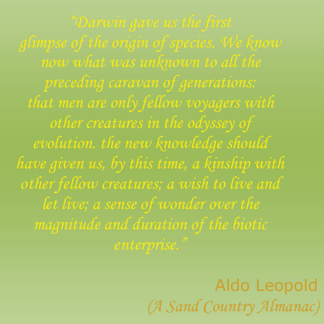
Contents:
Data Collection
Database narrative
Data Dictionary
Business rules
Normalization
Erd
Struggles and success
Query
Thank you

Slide 3

Data Collection
Bannerghatta National park and Zoo, Bangalore, INDIA

Slide 4
Database Narrative:
Animal related data- Animal, species, enclosure, feedings
Employee related data- departments, salary, employee
Others-Sponsors, visitors.
Notes:
▫ Database does not just contain data, but also contains definition of the structure of data, that can be considered ‘Meta data’; It includes many related info : table column definition, index and key info, constraints, etc

Slide 5
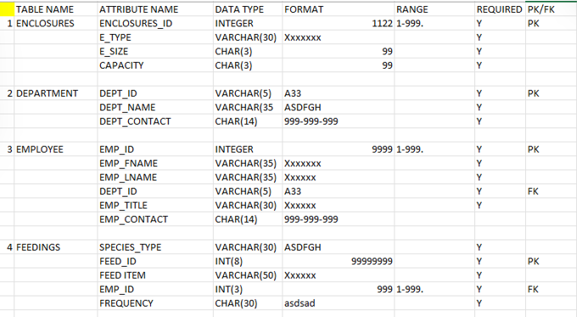
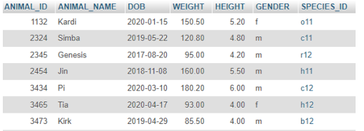
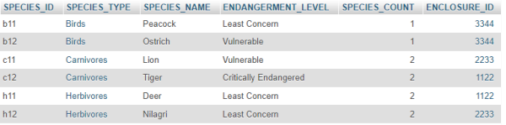
Data Dictionary
Notes:
A data dictionary provides a detailed description of the data elements used in a database. Here's a simplified data dictionary for the Zoo database:
Explain the table

Slide 6
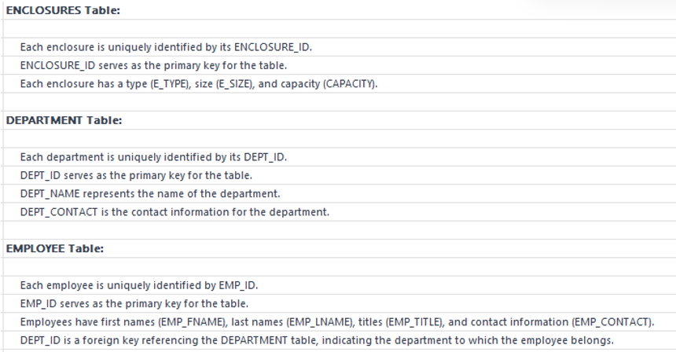
Business Rules

Slide 7
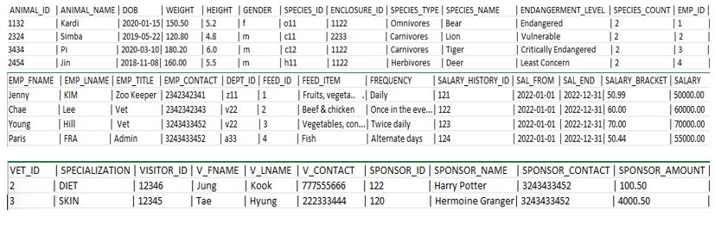
Normalization
Notes:
Database normalization, or simply normalization, is the process of restructuring a relational database in accordance with a series of socalled normal forms in order to reduce data redundancy and improve data integrity.
Normalization entails organizing the columns (attributes) and tables (relations) of a database to ensure that their dependencies are properly enforced by database integrity constraints

Slide 8
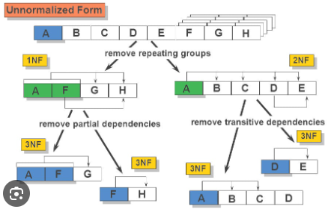
1NF
Conversion To First Normal Form
Step 1: Eliminate the Repeating Groups
Step 2: Identify the Primary Key
Step 3: Identify All Dependencies

Slide 9
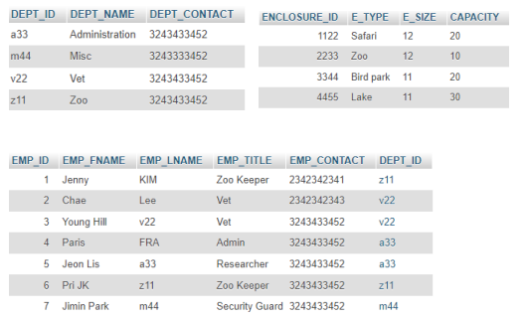
2NF
Conversion To Second Normal Form:
Step 1: Make New Tables to Eliminate Partial Dependencies
Step 2: Reassign Corresponding Dependent Attributes
Notes:
To convert a relation (table) to the Second Normal Form (2NF), it's essential to eliminate partial dependencies. A partial dependency occurs when some attributes in a composite primary key depend on only a part (a subset) of the primary key rather than the entire key. In this step, you create new tables to address these partial dependencies.
we'll consider the relationship between the DEPARTMENT and EMPLOYEE tables.
Previously dept was included in emp table- by apply 3nf->a separate table for dept was created
This decomposition eliminates partial dependencies, and the tables now adhere to the Second Normal Form (2NF).

Slide 10
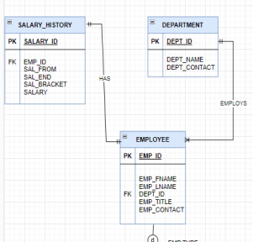
3NF
Conversion To Third Normal Form
Step 1: Make New Tables to Eliminate Transitive Dependencies
Step 2: Reassign Corresponding Dependent Attributes
Notes:
To achieve Third Normal Form (3NF), we need to ensure that there are no transitive dependencies in the tables. Let's consider the relationship between the EMPLOYEE, DEPARTMENT, and SALARY_HISTORY tables, there is a transitive dependency here..
Which can be removed by applying 3nf: We can create separate salary_history table-Now, we can see that the SALARY_HISTORY table only depends on its primary key, and is in Third Normal Form (3NF).

Slide 11
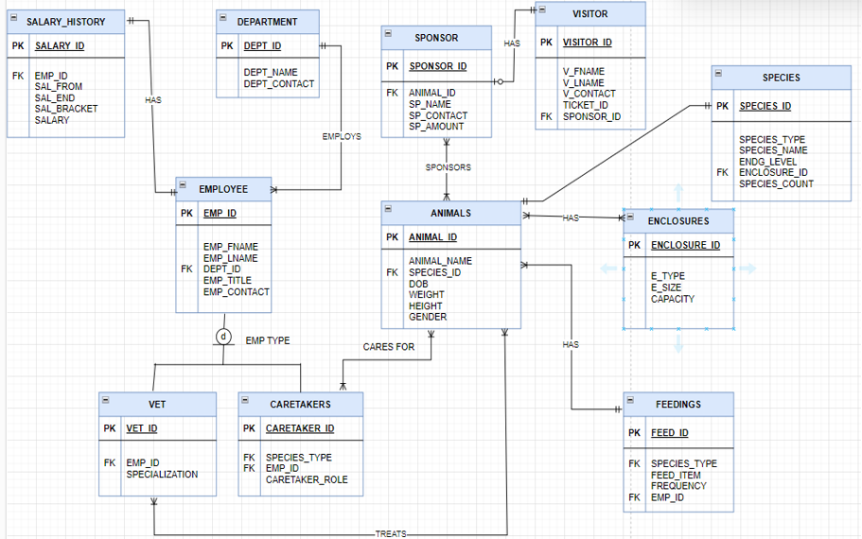
Entity-relationship model
Notes:
: Entity-Relationship data model is the common technique used in database design. It captures the relationships between database tables and represent them in a graphical way. The relationships between two entities can be 1:1, 1:N, or M:N. And it is usually established through ‘foreign key’ constraint.

Slide 12
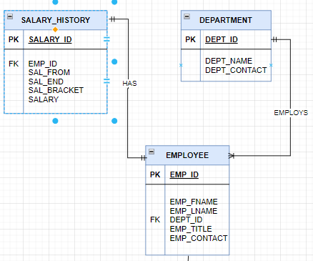
1:1 relationship
The case of 1:1 relationship between EMPLOYEE and DEPARTMENT based on the business rule “one EMPLOYEE is the manager of one DEPARTMENT, and one DEPARTMENT is managed by one EMPLOYEE.” In that case, there are two options for selecting and placing the foreign key:
Place a foreign key in both entities- this solution is not recommended because it duplicates work.
Place a foreign key in one of the entities-the primary key of one of the two entities appears as a foreign key in the other entity

Slide 13
Time variant data
Data whose values are a function of time. For example, timevariant data can be seen at work when a company’s history of all administrative appointments is tracked
This type of data is dynamic and captures variations or modifications in a particular attribute or set of attributes over different points in time. The concept of time-variant data is particularly relevant in database management and analysis, especially when dealing with temporal aspects of information.

Slide 14
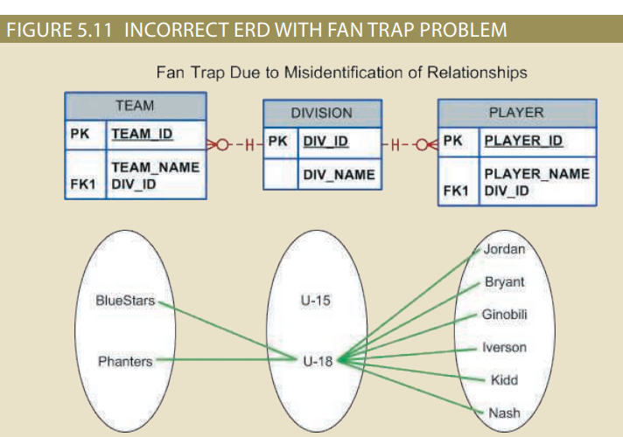
Struggles and success
Fan trap - A design trap that occurs when one entity is in two 1:M relationships with other entities, thus producing an association among the other entities that is not expressed in the model.

Slide 15
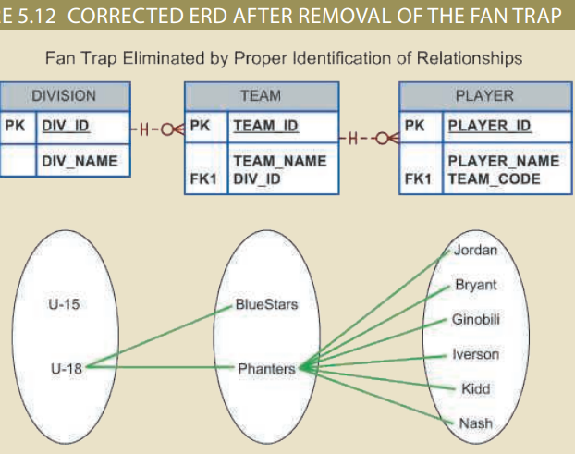
Solution
Proper Identification of relationships
Create views that joins caretaker-animals-species based on specific criteria to avoid ambiguity.

Slide 16

Thank you
Parimala Anjanappa

